Slide 1


OBSTACLE AVOIDANCE ROBOT
SRI RAMAKRISHNA INSTITUTE OF TECHNOLOGY (An Autonomous Institution) Pachapalayam , Perur Chettipalayam , Coimbatore – 641010.
NAME : SRI KANTESHWAR CS
CLASS: III B.E-EEE
REG.NO: 71382203020
COURSE CODE:20EEP34
COURSE TITLE:INTRODUCTION TO RASPBERRY PI

Slide 2
OBJECTIVE:
Autonomous Navigation: Move without human intervention.
Obstacle Detection: Identify obstacles using sensors.
Collision Avoidance: Prevent collisions by stopping or changing direction.
Efficient Pathfinding: Choose the best route around obstacles.
Real-Time Processing: Respond quickly to changing environments.
Safety: Operate without damaging itself or its surroundings.

Slide 3
HARDWARE REQUIREMENTS
Raspberry Pi Pico microcontroller(RS20)
Ultrasonic sensor(HC-SR04)
Servo Motor(SG-90)
Dc motor
Motor driver(L298N)
Li-ion batteries
Connecting Wires
SOFTWARE REQUIREMENTS
Thonny IDE

Slide 4
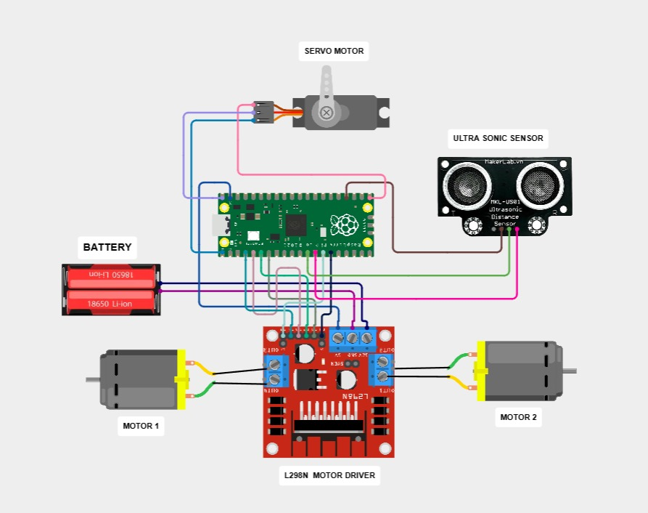
BLOCK DIAGRAM:

Slide 5
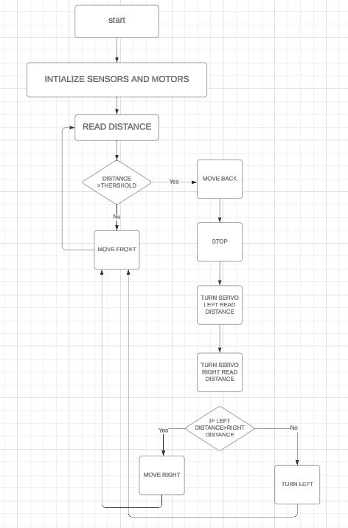
FLOW CHART:

Slide 6
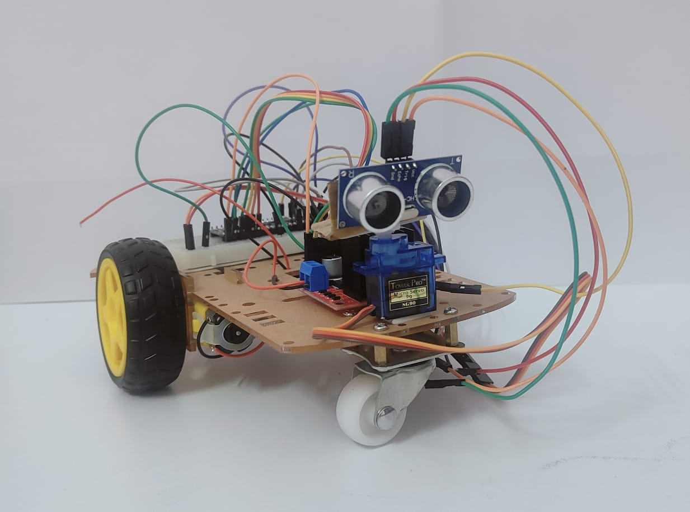
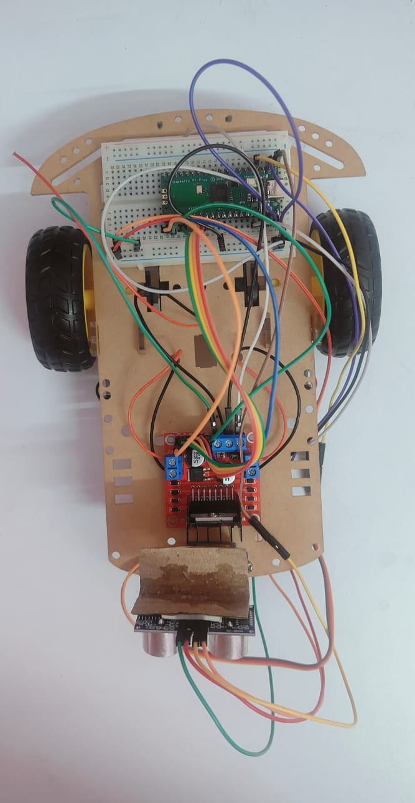
HARDWARE SETUP

Slide 7
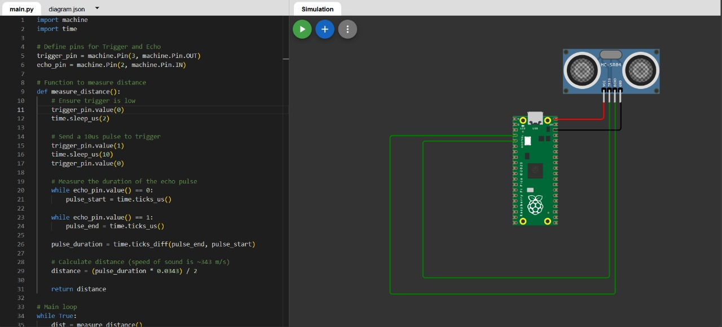
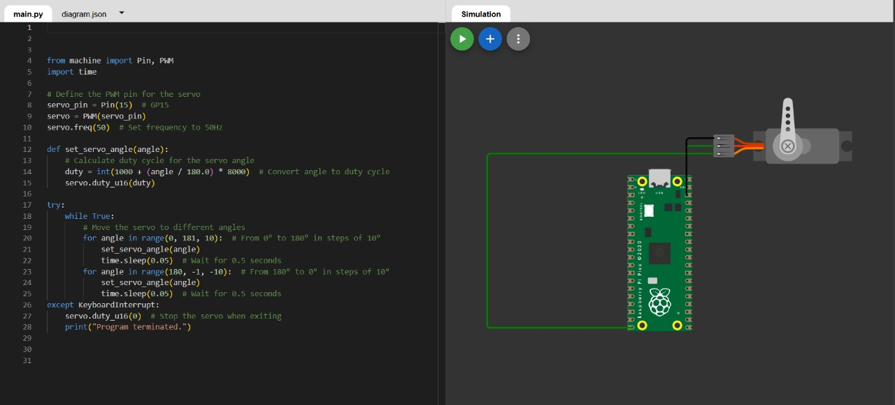
WOKWI SIMULATION
ULTRASONIC SENSOR
SERVO MOTOR
https://wokwi.com/projects/414992071613797377
https://wokwi.com/projects/414992000702780417

Slide 8
CONCLUSION
Effective Navigation: Successfully detects and avoids obstacles in real-time.
Cost-Effective: Uses the low-cost Raspberry Pi Pico for autonomous navigation.
Scalable: Can be enhanced with additional sensors and advanced algorithms.
Flexible Programming: Developed with Micro Python , allowing easy modifications.
Practical Applications: Suitable for autonomous vehicles and smart systems.
Future-Proof: Serves as a foundation for more advanced robotics projects.
Educational Value: Great for learning embedded systems and robotics.

